Slide 1
Pensinyalan (2)
Perbandingan antara sinyal analog dan digital

Slide 2
3.4 Analog versus Digital
Low-pass versus Band-pass
Digital Transmission
Analog Transmission

Slide 3
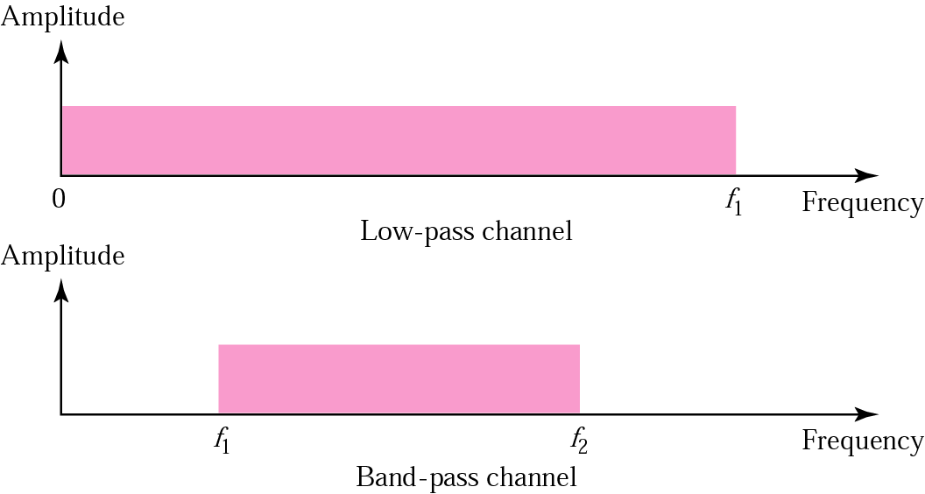
Figure 3.19 Low-pass and band-pass

Slide 4
Note:
The analog bandwidth of a medium is expressed in hertz; the digital bandwidth, in bits per second.

Slide 5
Note:
Digital transmission needs a
low-pass channel.

Slide 6
Analog transmission can use a band-pass channel.

Slide 7
3.5 Data Rate Limit
Noiseless Channel: Nyquist Bit Rate
Noisy Channel: Shannon Capacity
Using Both Limits

Slide 8
Example 7
Consider a noiseless channel with a bandwidth of 3000 Hz transmitting a signal with two signal levels. The maximum bit rate can be calculated as
Bit Rate = 2 × 3000 × log₂ 2 = 6000 bps

Slide 9
Example 8
Consider the same noiseless channel, transmitting a signal with four signal levels (for each level, we send two bits). The maximum bit rate can be calculated as:
Bit Rate = 2 x 3000 x log₂ 4 = 12,000 bps

Slide 10
Example 9
Consider an extremely noisy channel in which the value of the signal-to-noise ratio is almost zero. In other words, the noise is so strong that the signal is faint. For this channel the capacity is calculated as
C = B log₂ (1 + SNR) = B log₂ (1 + 0)
= B log₂ (1) = B × 0 = 0

Slide 11
Example 10
We can calculate the theoretical highest bit rate of a regular telephone line. A telephone line normally has a bandwidth of 3000 Hz (300 Hz to 3300 Hz). The signal-to-noise ratio is usually 3162. For this channel the capacity is calculated as
C = B log₂ (1 + SNR) = 3000 log₂ (1 + 3162)
= 3000 log₂ (3163)
C = 3000 × 11.62 = 34,860 bps

Slide 12
Example 11
We have a channel with a 1 MHz bandwidth. The SNR for this channel is 63; what is the appropriate bit rate and signal level?
Solution
First, we use the Shannon formula to find our upper limit.
C = B log₂ (1 + SNR) = 10⁶ log₂ (1 + 63) = 10⁶ log₂ (64) = 6 Mbps
Then we use the Nyquist formula to find the
number of signal levels.
4 Mbps = 2 × 1 MHz × log₂ L ➔ L = 4

Slide 13
3.6 Transmission Impairment
Attenuation
Distortion
Noise

Slide 14
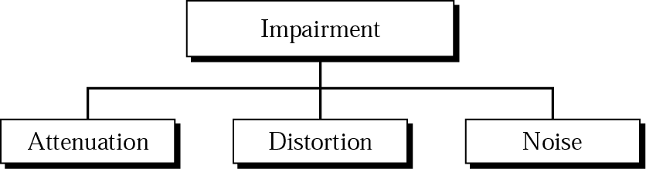
Figure 3.20 Impairment types

Slide 15
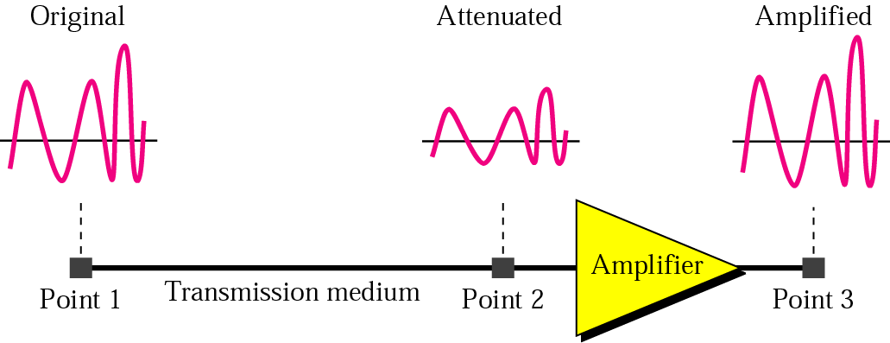
Figure 3.21 Attenuation

Slide 16
Example 12
Imagine a signal travels through a transmission medium and its power is reduced to half. This means that P2 = 1/2 P1. In this case, the attenuation (loss of power) can be calculated as
Solution
10 log₁₀ (P2/P1) = 10 log₁₀ (0.5P1/P1) = 10 log₁₀ (0.5)
= 10(–0.3) = –3 dB

Slide 17
Example 13
Imagine a signal travels through an amplifier and its power is increased ten times. This means that P2 = 10 ¥ P1. In this case, the amplification (gain of power) can be calculated as
10 log₁₀ (P2/P1) = 10 log₁₀ (10P1/P1)
= 10 log₁₀ (10) = 10 (1) = 10 dB

Slide 18
Example 14
One reason that engineers use the decibel to measure the changes in the strength of a signal is that decibel numbers can be added (or subtracted) when we are talking about several points instead of just two (cascading). In Figure 3.22 a signal travels a long distance from point 1 to point 4. The signal is attenuated by the time it reaches point 2. Between points 2 and 3, the signal is amplified. Again, between points 3 and 4, the signal is attenuated. We can find the resultant decibel for the signal just by adding the decibel measurements between each set of points.

Slide 19
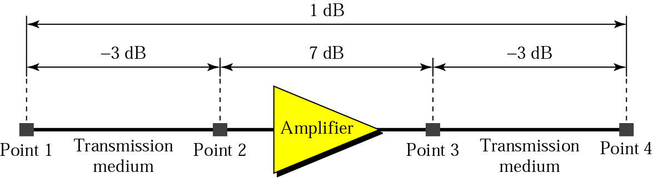
Figure 3.22 Example 14
dB = –3 + 7 – 3 = +1

Slide 20
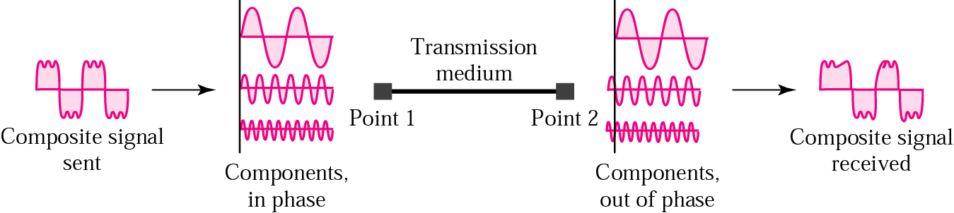
Figure 3.23 Distortion

Slide 21
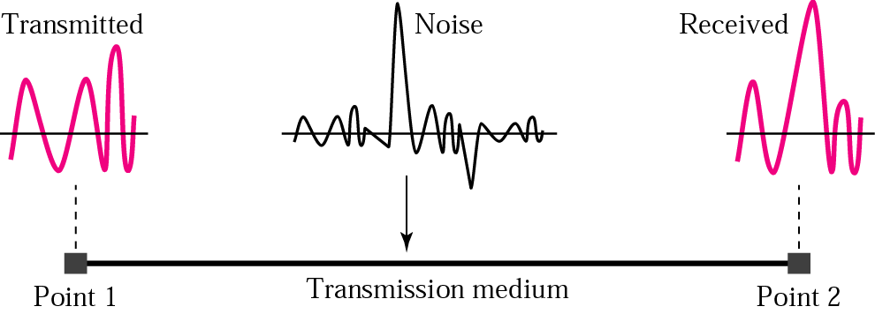
Figure 3.24 Noise

Slide 22
3.7 More About Signals
Throughput
Propagation Speed
Propagation Time
Wavelength

Slide 23
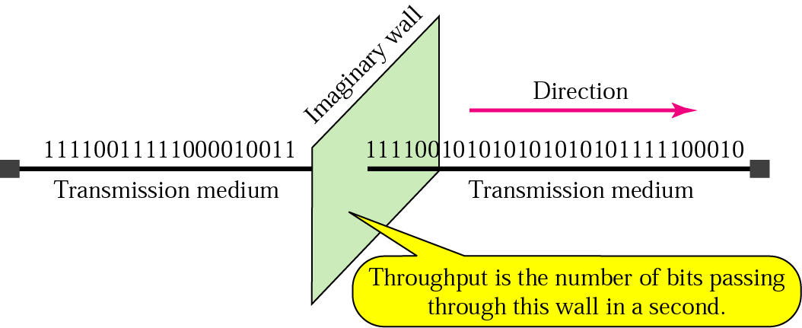
Figure 3.25 Throughput

Slide 24
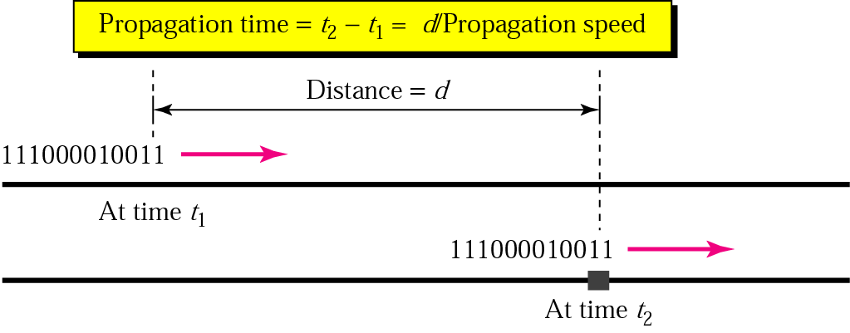
Figure 3.26 Propagation time

Slide 25
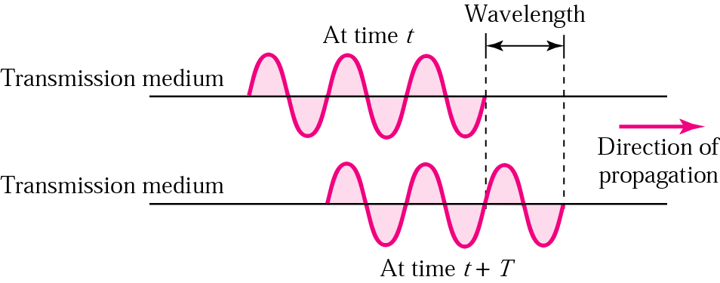
Figure 3.27 Wavelength

