Slide 1
Lapisan Transport (2)
TCP, THREE-WAY HANDSHAKE, WINDOW

Slide 2
TCP
TCP adalah protocol yang berorientasi pada koneksi (connection-oriented protocol);
TCP akan membuat sebuat koneksi virtual antara dua komputer terlebih dahulu, sebelum keduanya saling bertukar data
TCP mempunyai mekanisme flow dan error control
Analogi : mengirimkan berita melalui telepon
Topik diskusi :
TCP Services
TCP Features
Segment
A TCP Connection
Flow Control
Error Control

Slide 3
Table 2 Well-known ports used by TCP

Slide 4
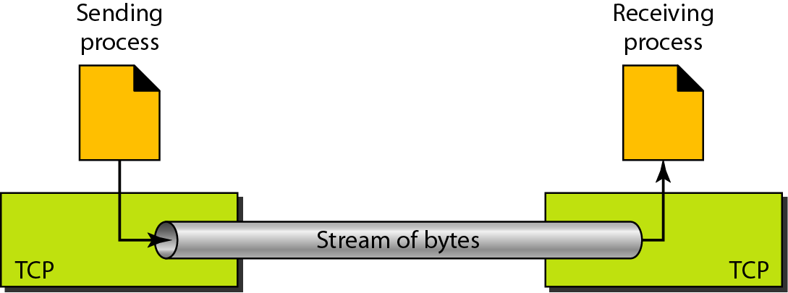
Figure 13 Pengiriman bytes stream

Slide 5
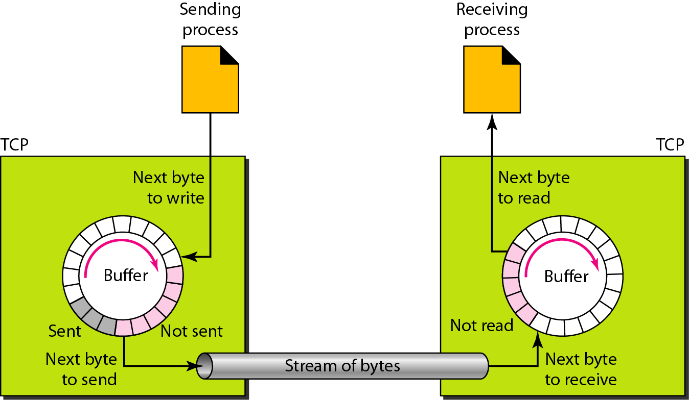
Figure 14 Sending and receiving buffers

Slide 6
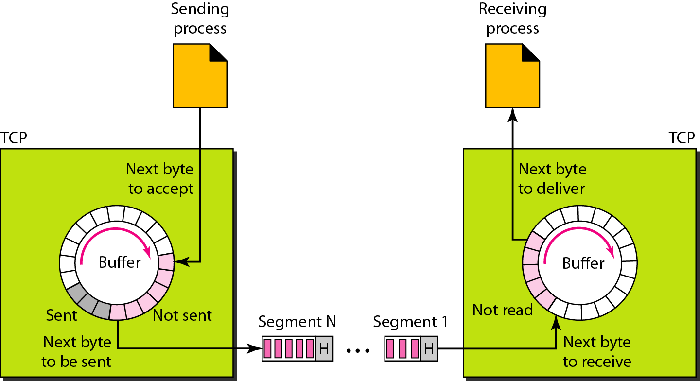
Figure 15 TCP segments

Slide 7

Note
Segment yang ditransfer pada setiap koneksi akan diberi nomor (baca : sequence ID) oleh TCP.
Penomoran dimulai dengan nomor yang dibangkitkan secara acak (relatif)

Slide 8
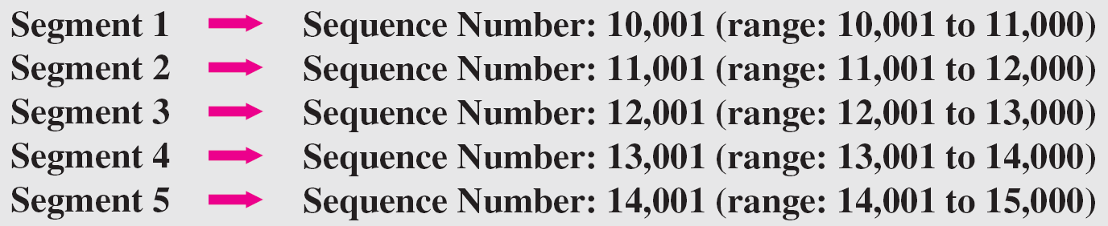
Example 3
Dibawah ini adalah contoh penomoran pada setiap segment:

Slide 9
Note
Nilai sekuen mendefinisikan nomor byte data pertama yang terkandung pada segment

Slide 10
Note
Nilai dari koom acknowledgment pada segment, mendefinisikan nomor byte selanjutnya yang diharapkan akan diterima
Nomor acknowledgment bersifat kumulatif.

Slide 11
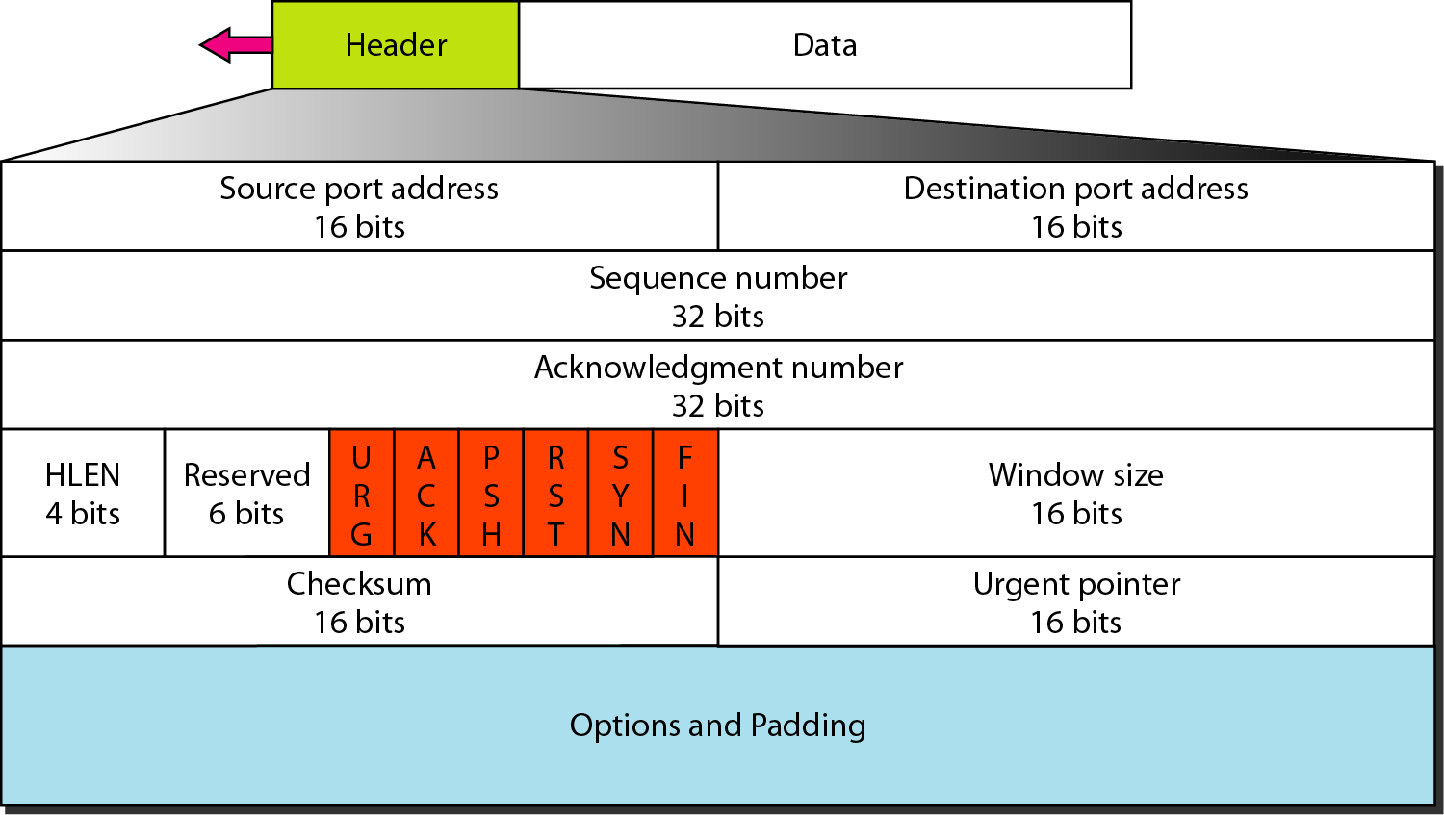
Figure 16 Format TCP segment

Slide 12
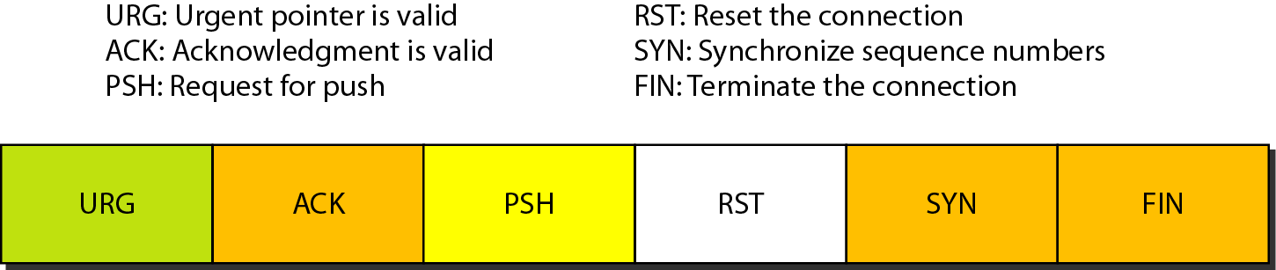
Figure 17 Control field

Slide 13
Table 3 Description of flags in the control field

Slide 14
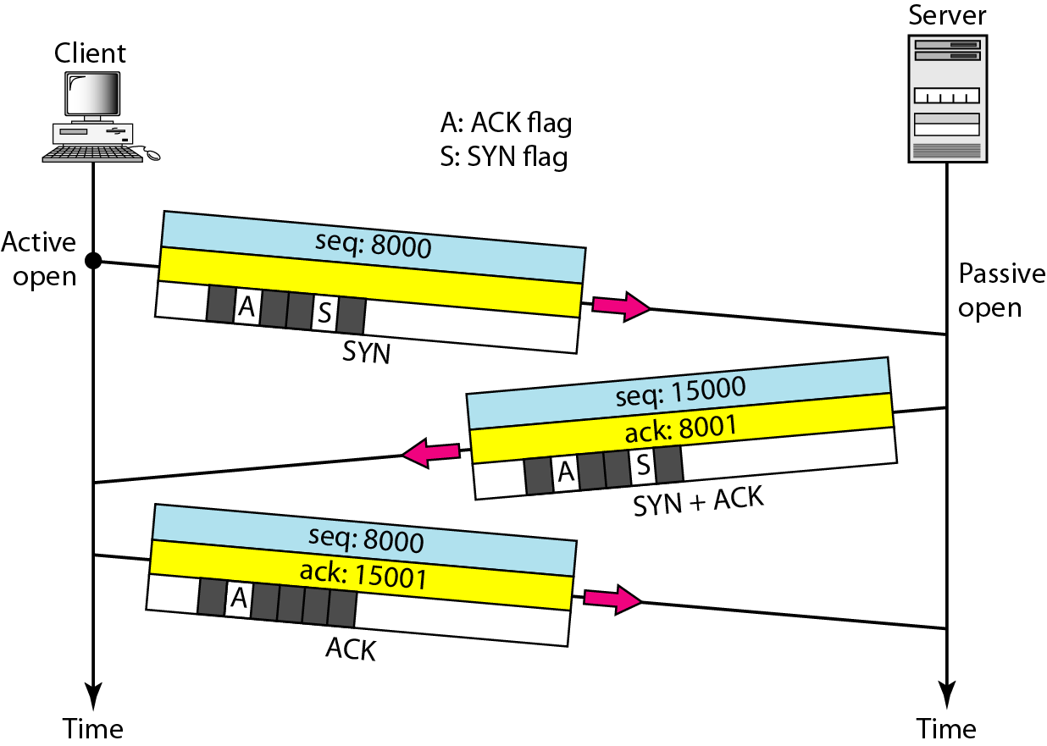
Figure 18 Connection establishment menunggakan three-way handshaking

Slide 15
Note
A SYN segment tidak dapat membawa data, tetapi membutuhkan 1 (satu) sequence number.

Slide 16
Note
A SYN + ACK segment tidak dapat membawa data, tetapi membutuhkan 1 (satu) sequence number.

Slide 17
Note
Sebuah ACK segment, apabila tidak dalam mebawa data, maka ACK tidak membutuhkan satu sequence number.

Slide 18
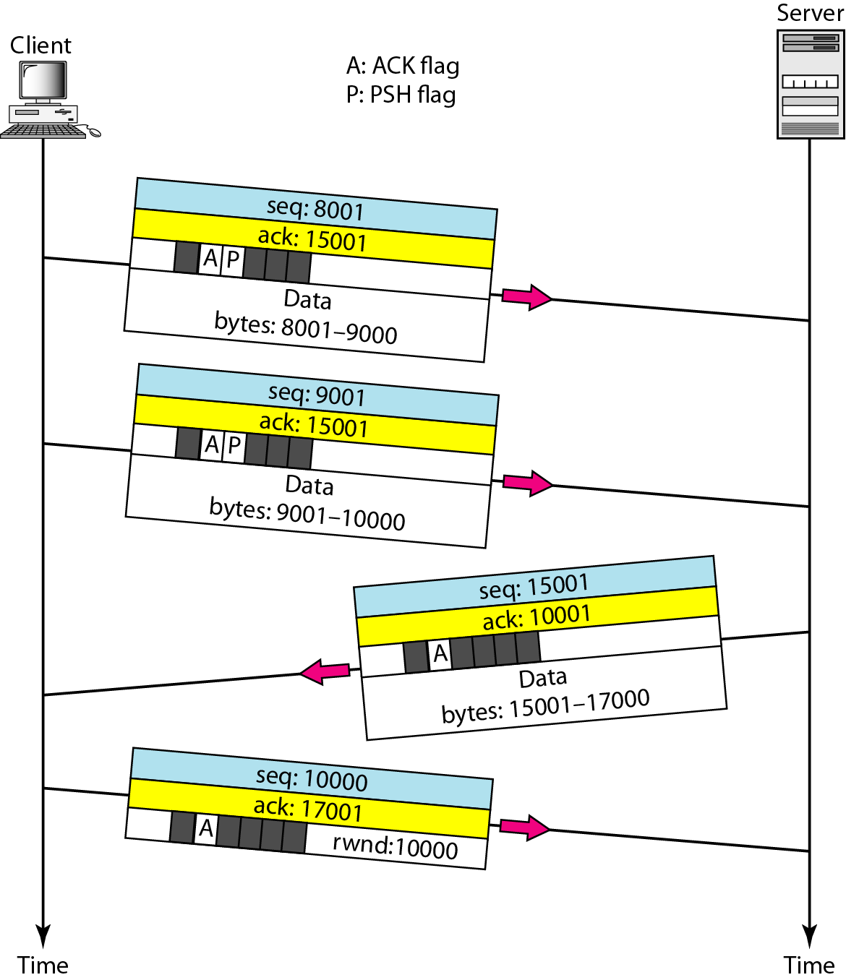
Figure 19 Data transfer

Slide 19
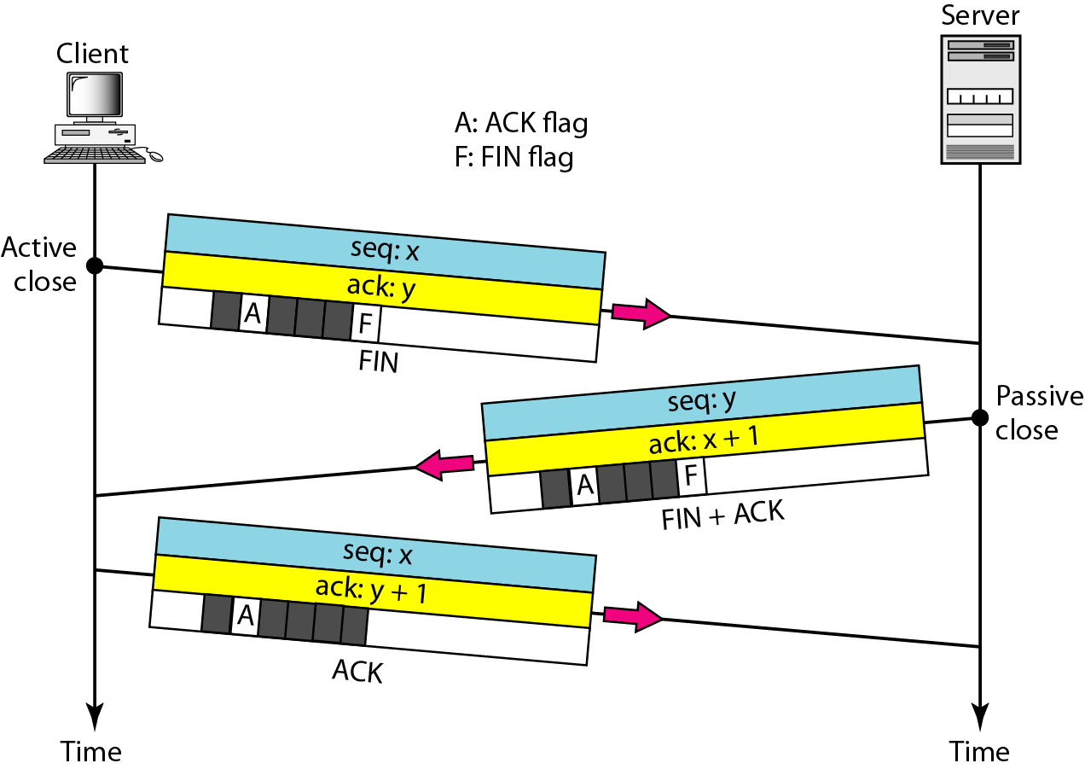
Figure 20 Connection termination using three-way handshaking

Slide 20
Note
The FIN segment membutuhkan satu sequence number apabila tidak sedang membawa data

Slide 21
Note
The FIN + ACK segment consumes
one sequence number if it
does not carry data.

Slide 22
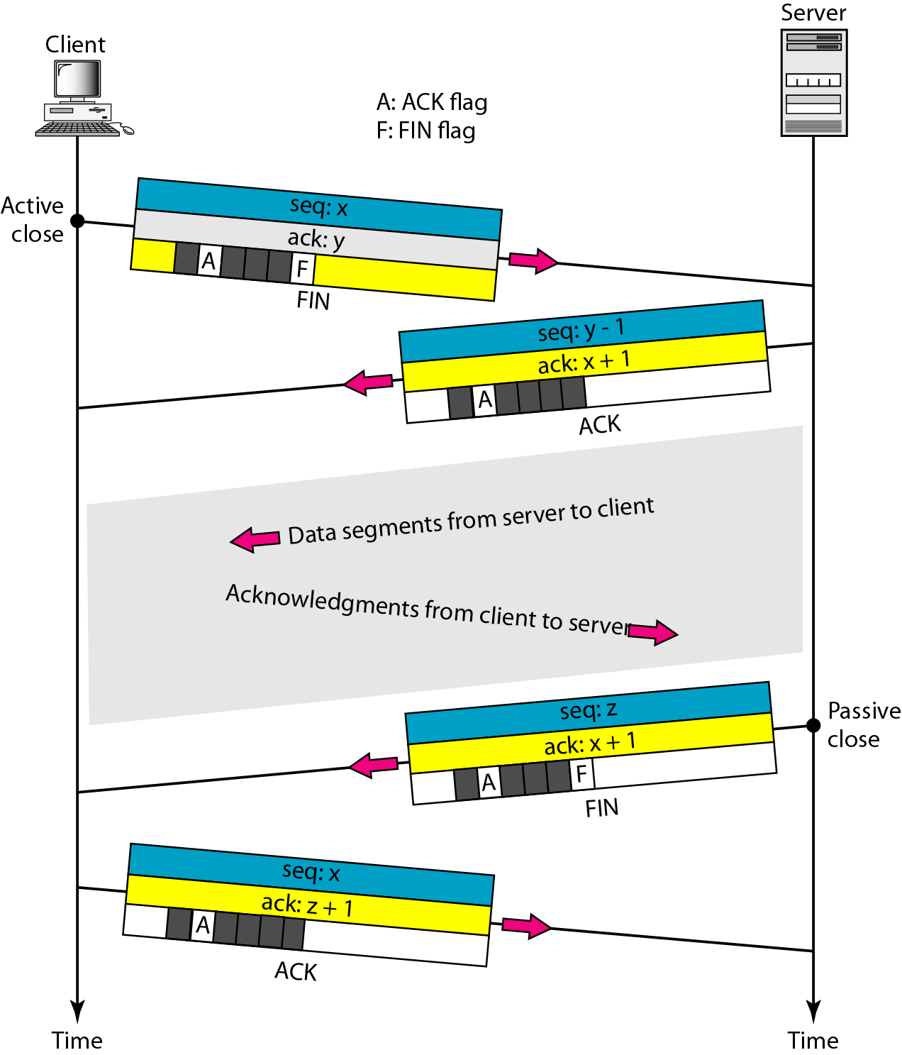
Figure 21 Half-close

Slide 23
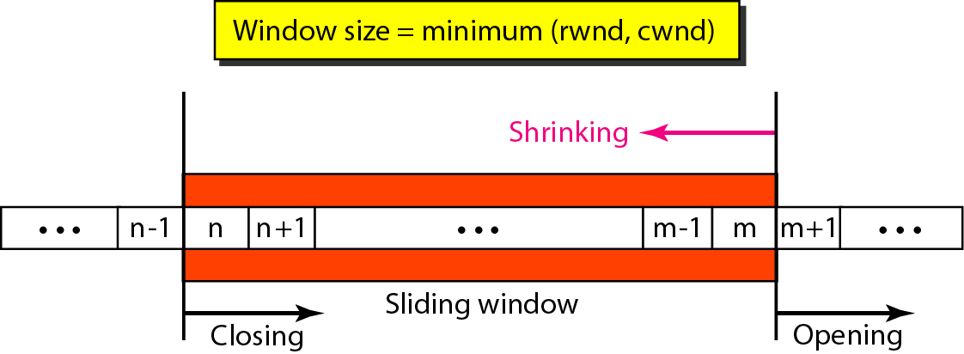
Figure 22 Sliding window

Slide 24
Note
A sliding window is used to make transmission more efficient as well as
to control the flow of data so that the destination does not become
overwhelmed with data.
TCP sliding windows are byte-oriented.

Slide 25
Example 4
What is the value of the receiver window (rwnd) for host A if the receiver, host B, has a buffer size of 5000 bytes and 1000 bytes of received and unprocessed data?
Solution
The value of rwnd = 5000 − 1000 = 4000. Host B can receive only 4000 bytes of data before overflowing its buffer. Host B advertises this value in its next segment to A.

Slide 26
Example 5
What is the size of the window for host A if the value of rwnd is 3000 bytes and the value of cwnd is 3500 bytes?
Solution
The size of the window is the smaller of rwnd and cwnd, which is 3000 bytes.

Slide 27
Example.6
Figure 23.23 shows an unrealistic example of a sliding window. The sender has sent bytes up to 202. We assume that cwnd is 20 (in reality this value is thousands of bytes). The receiver has sent an acknowledgment number of 200 with an rwnd of 9 bytes (in reality this value is thousands of bytes). The size of the sender window is the minimum of rwnd and cwnd, or 9 bytes. Bytes 200 to 202 are sent, but not acknowledged. Bytes 203 to 208 can be sent without worrying about acknowledgment. Bytes 209 and above cannot be sent.

Slide 28
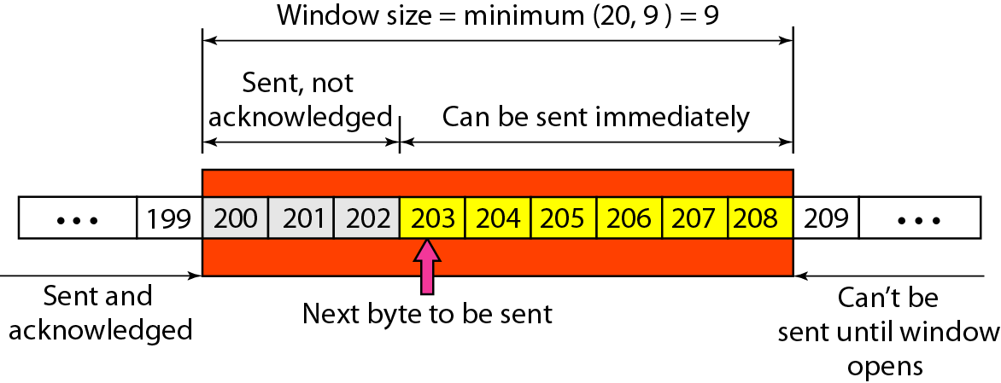
Figure 23 Example 23.6

Slide 29
Some points about TCP sliding windows:
❏ The size of the window is the lesser of rwnd and
cwnd.
❏ The source does not have to send a full window’s
worth of data.
❏ The window can be opened or closed by the
receiver, but should not be shrunk.
❏ The destination can send an acknowledgment at
any time as long as it does not result in a shrinking
window.
❏ The receiver can temporarily shut down the
window; the sender, however, can always send a
segment of 1 byte after the window is shut down.

Slide 30
ACK segments do not consume sequence numbers and are not acknowledged.

Slide 31
Note
In modern implementations, a retransmission occurs if the retransmission timer expires or three duplicate ACK segments have arrived.

Slide 32
Note
No retransmission timer is set for an ACK segment.

Slide 33
Note
Data may arrive out of order and be temporarily stored by the receiving TCP,
but TCP guarantees that no out-of-order segment is delivered to the process.

Slide 34
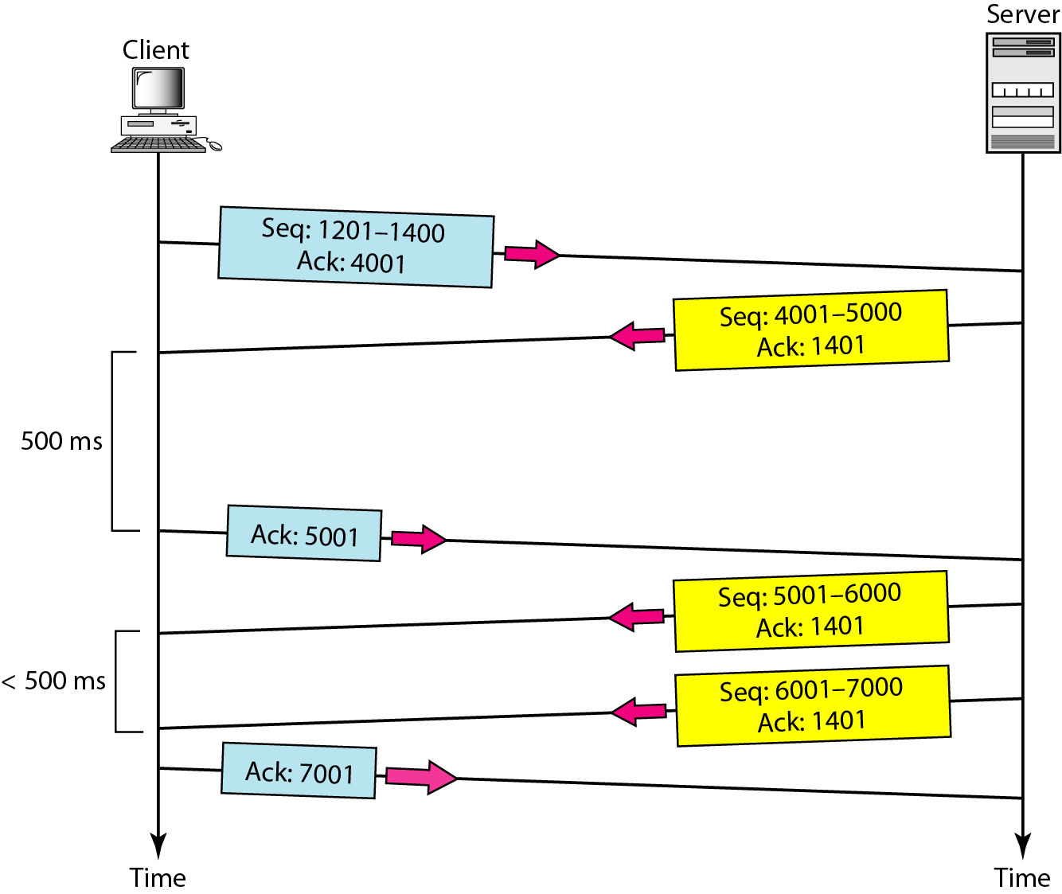
Figure 24 Normal operation

Slide 35
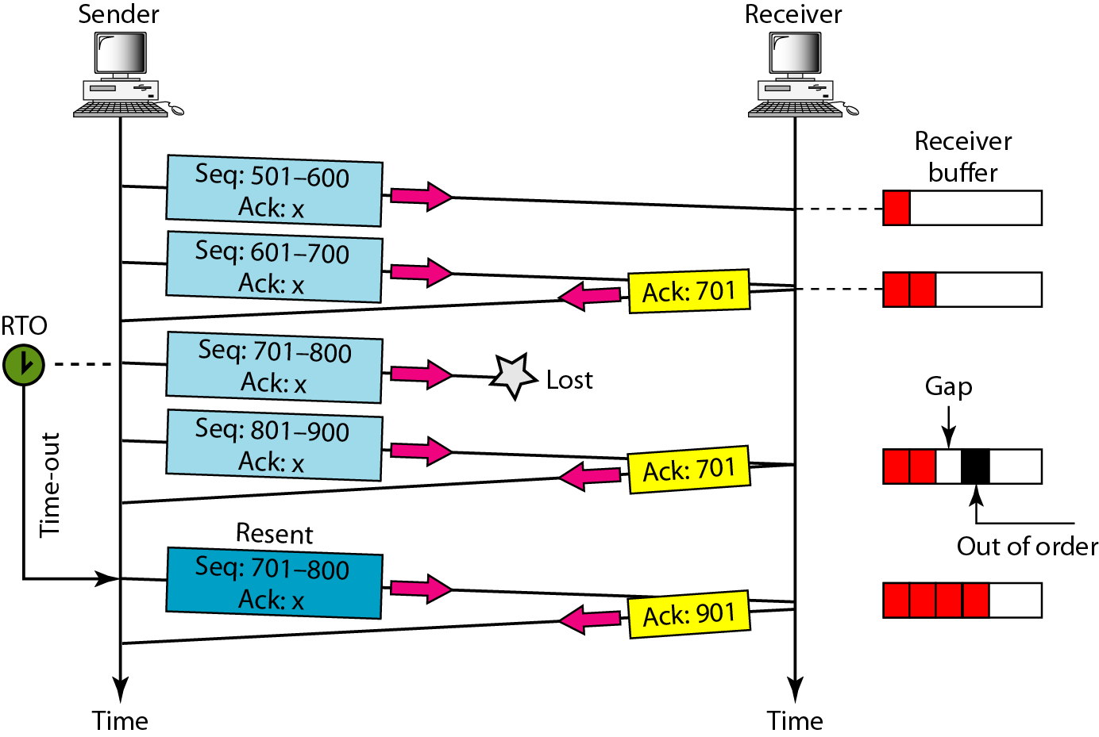
Figure 25 Lost segment

Slide 36
Note
The receiver TCP delivers only ordered data to the process.

Slide 37
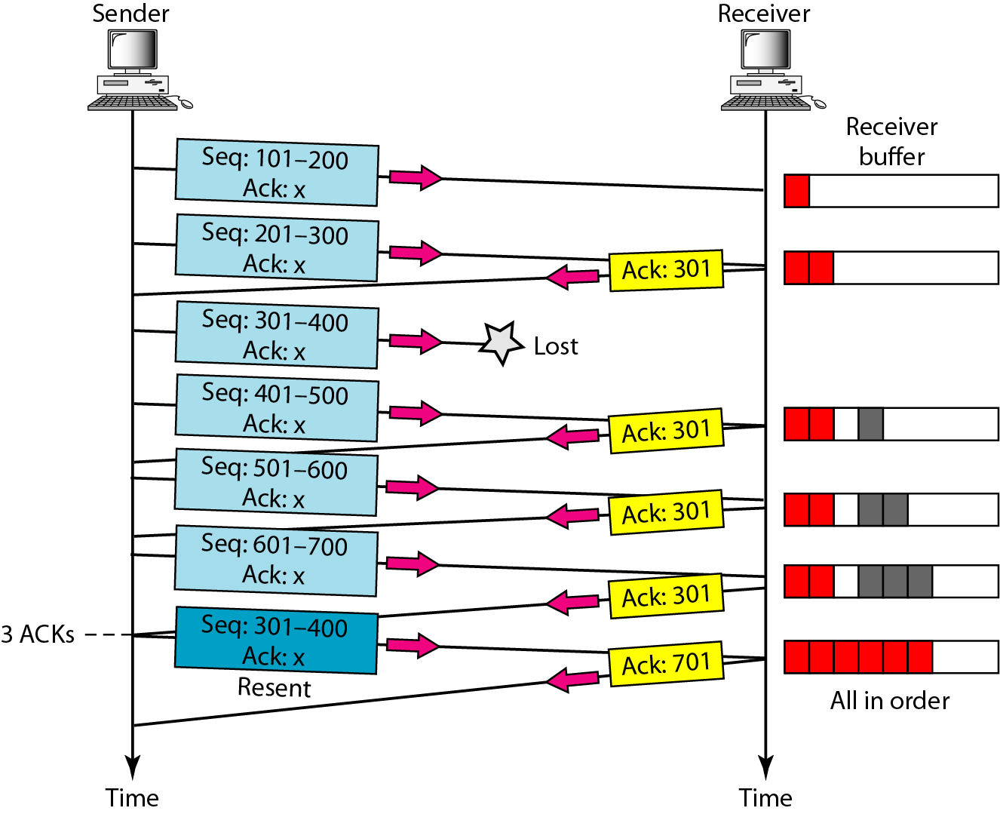
Figure 26 Fast retransmission

